Slide 1
JAX-RS practice
Saint Petersburg, 2016

Slide 2
Практика: maven
Генерируем maven-based проект.
mvn archetype:generate -DgroupId=com.tsystems -DartifactId=RestTesting -DarchetypeArtifactId=maven-archetype-webapp -DinteractiveMode=false
Подключаем зависимости.
<dependencies>
<dependency>
<groupId>com.sun.jersey</groupId>
<artifactId>jersey-server</artifactId>
<version>1.8</version>
</dependency>
<dependency>
<groupId>com.sun.jersey</groupId>
<artifactId>jersey-json</artifactId>
<version>1.8</version>
</dependency>
<dependency>
<groupId>com.sun.jersey</groupId>
<artifactId>jersey-client</artifactId>
<version>1.8</version>
</dependency>
<dependency>
<groupId>com.fasterxml.jackson.core</groupId>
<artifactId>jackson-databind</artifactId>
<version>2.6.3</version>
</dependency>
</dependencies>

Slide 3
Практика: web.xml
Конфигурируем web.xml
<servlet>
<servlet-name>jersey-servlet</servlet-name>
<servlet-class>
com.sun.jersey.spi.container.servlet.ServletContainer
</servlet-class>
<init-param>
<param-name>com.sun.jersey.api.json.POJOMappingFeature</param-name>
<param-value>true</param-value>
</init-param>
<load-on-startup>1</load-on-startup>
</servlet>
<servlet-mapping>
<servlet-name>jersey-servlet</servlet-name>
<url-pattern>/rest/*</url-pattern>
</servlet-mapping>

Slide 4
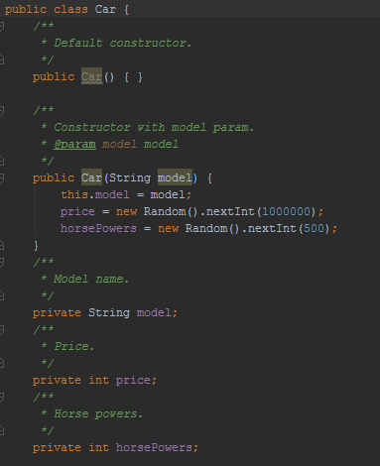
Практика: POJO
Создаём entity-класс + геттеры/сеттеры + toString().

Slide 5
Практика: REST service
Создаём сервис.
@Path("/car")
public class GetCarService {
@GET
@Path("/{brandName}")
@Produces(MediaType.APPLICATION_JSON)
public Car getCar(@PathParam("brandName") String brandName) {
return new Car(brandName);
}
@POST
@Path("/post")
@Consumes(MediaType.APPLICATION_JSON)
@Produces(MediaType.APPLICATION_JSON)
public Car patchCar(Car car) {
return new Car(car.getModel());
}
}
Деплоим и стучимся по адресу http://localhost:8080/RestTesting/rest/car/Bentley
??????
Profit!

Slide 6
Практика: REST client
Создадим простой клиент для теста.
public class RestClient {
public static void main(String[] args) throws IOException {
Client client = Client.create();
WebResource webResource = client.resource("http://localhost:8080/RestTesting/rest/car/post");
Car car = new Car("Bentley");
ObjectMapper mapper = new ObjectMapper();
String JSONCar = mapper.writeValueAsString(car);
ClientResponse response = webResource
.accept(MediaType.APPLICATION_JSON)
.type(MediaType.APPLICATION_JSON)
.post(ClientResponse.class, JSONCar);
if (response.getStatus() != 200) {
throw new RuntimeException("Failed : HTTP error code : "
+ response.getStatus());
}
String output = response.getEntity(String.class);
Car newCar = mapper.readValue(output, Car.class);
System.out.println("Old car: " + car);
System.out.println("Output from Server ....");
System.out.println(newCar);
}
}

Slide 7

Вопросы

